Slide 1
SOCIAL ART INTERGRATION
TAMIL NADU AND WEST BENGAL

Slide 2
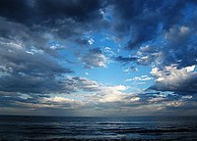
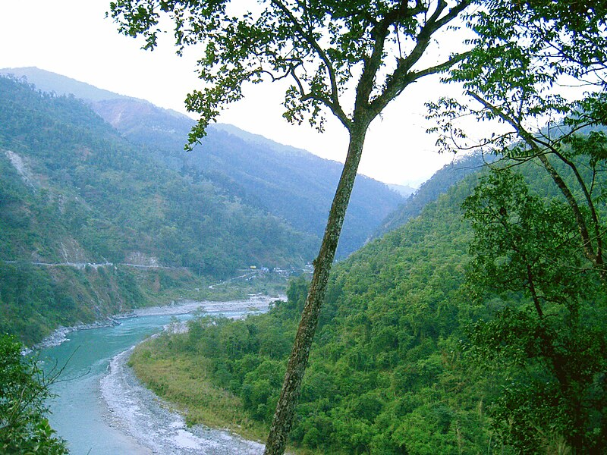
CLIMATE
TAMIL NADU
WEST BENGAL
Climate. The climate of Tamil Nadu is essentially tropical. In May and June, the hottest months, maximum daily temperatures in Chennai average about 100 °F (38 °C), while minimum temperatures average in the low 80s F (upper 20s C)
The climate of West Bengal is varied, with tropical savannahs in the southern portions of the state, to humid subtropical areas in the north. Temperatures vary widely, and there are five distinct seasons. The area is vulnerable to heavy rainfall, monsoons, and cyclones.

Slide 3
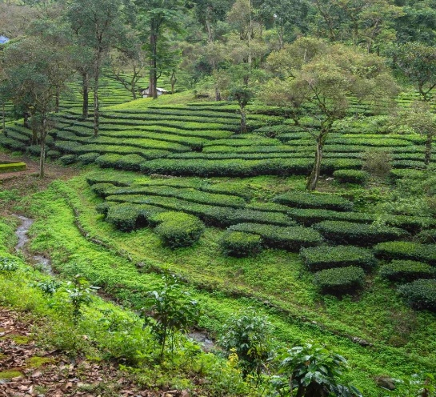
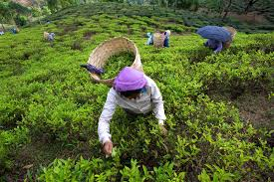
VEGETATION
TAMIL NADU
WEST BENGAL
Natural vegetation consists of littoral forests and plantations of casuarina and coconut, together with scattered trees, climbing vines, and grass. The Kaveri, Ponnaiyar, Palar, Vaigai, Tambraparni, Vellar, and Arni rivers flow east into the Bay of Bengal. The soils are red-loamy and sandy-loamy, both rich in iron.
The distribution of vegetation in northern West Bengal is dictated by elevation and precipitation. For example, the foothills of the Himalayas, the Dooars, are densely wooded with sal and other tropical evergreen trees. Above an elevation of 1,000 metres (3,300 ft), the forest becomes predominantly subtropical

Slide 4
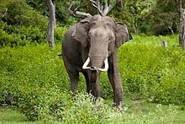
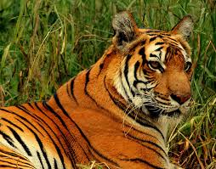
FLORA AND FAUNA
TAMIL NADU
WEST BENGAL
Rare and unique plant life includes Combretum ovalifolium, ebony (Diospyros nilagrica), Habenaria rariflora (orchid), Alsophila, Impatiens elegans, Ranunculus reniformis, and royal fern. Nilgiri tahr, an endangered animal found only in the Nilgiri Mountains, is the state animal
The Bengal wilderness is also home of an array of highly endangered species like the Asian Elephant , Great one horned Rhino, Gaur, Serow, Red Panda, Black Necked Crane, Great pied Hornbill, Goliath Heron, Estuarine Crocodile, Salvator Lizards, Olive Ridley Marine Turtle, rare Batagur terrapin, let alone being the

Slide 5
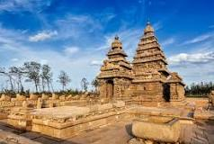

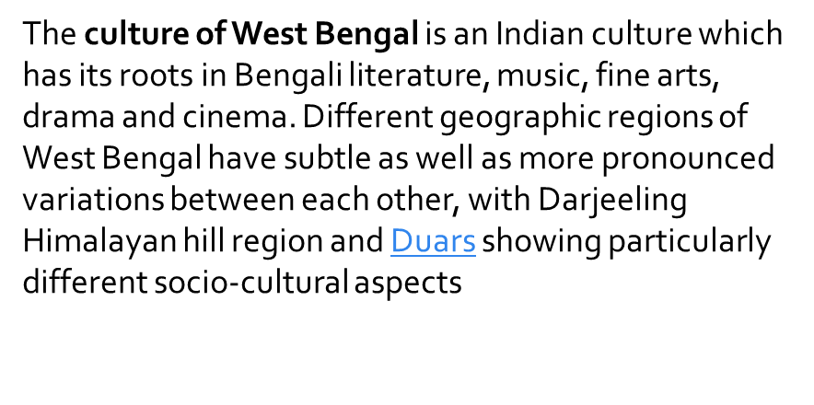
CULTURE
TAMIL NADU
WEST BENGAL
Hinduism lies at the core of the culture of Tamil Nadu. Among the most famous of the state's temples, which number in the tens of thousands, are the 7th- and 8th-century structures at Mamallapura, which were designated a UNESCO World Heritage Site in 1984

Slide 6
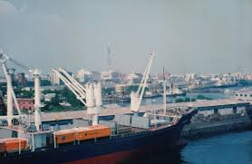
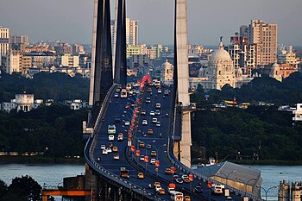
INDUSTRY
TAMIL NADU
WEST BENGAL
Tamil Nadu has the second largest state economy in India. The state also hosts the highest number of factories in the country. The state is 48.40% urbanised, accounting for around 9.26% of the urban population in the country, while the state as a whole accounted for 5.96% of India's total population in the 2011 census. Services contributes to 54% to the gross domestic product of the state, followed by manufacturing at 33% and agriculture at 13%.
The economy of West Bengal is a mixed middle-income developing social market economy and the largest Eastern Indian economy with a substantial public sector. It is the India's sixth-largest economy by nominal GDP.
West Bengal is the primary business and financial hub of Eastern India. The state primarily dependent on agriculture and medium-sized industry. West Bengal has jute and tea industry. West Bengal is rich in minerals like coal, limestone, iron ore , copper , lead and zinc.

Slide 7


Slide 8
OUR TEAM MEMBERS
SANJITH RAM
HARI
SURYA
RUDHRESH
KRUTHICK PRANAV
PAVAN BALA
NATHUL
KOUSHIK

